Slide 1
Computing Scattering Intensities with Sassena
SHUG-15
Jose M. Borreguero
Neutron Data Analysis and Visualization Division
Center for Accelerating Materials Modelling

Slide 2

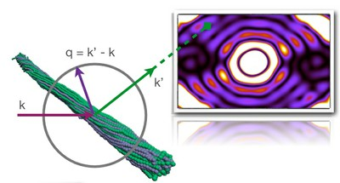
What is ?
“Sassena is a highly scalable parallelized software for calculating neutron and X-ray scattering intensities from all-atomic molecular dynamics simulations.”
http://www.sassena.org/

Slide 3
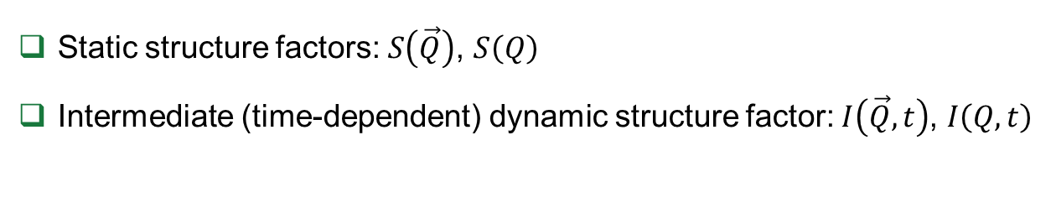
What does Sassena Calculate?
Static structure factors: $S\left(\vec{Q}\right)$, $S\left(Q\right)$
Intermediate (time-dependent) dynamic structure factor: $I\left(\vec{Q},t\right)$, $I\left(Q,t\right)$

